Slide 1
K-Nearest Neighbor Classification
Swarna Chaudhary
Assistant Professor
Swarna.Chaudhary@pilani.bits-pilani.ac.in

Slide 2

The slides presented here are obtained from the authors of the books and from various other contributors. I hereby acknowledge all the contributors for their material and inputs.
I have added and modified a few slides to suit the requirements of the course.

Slide 3
In this segment
kNN classifier – Introduction
Model Evaluation Measures
Finding optimal k
Python Implementation

Slide 4
Lazy vs. Eager Learning
Lazy vs. eager learning
Lazy learning (e.g., instance-based learning): Simply stores training data (or only minor processing) and waits until it is given a test tuple
Eager learning (the above discussed methods): Given a set of training set, constructs a classification model before receiving new (e.g., test) data to classify
Lazy: less time in training but more time in predicting

Slide 5
Lazy Learner: Instance-Based Methods
Instance-based learning:
Store training examples and delay the processing (“lazy evaluation”) until a new instance must be classified
Typical approaches
k-nearest neighbor approach
Instances represented as points in a Euclidean space.
Case-based reasoning
Uses symbolic representations and knowledge-based inference

Slide 6
k-Nearest Neighbor Classifier
Nearest Neighbour classifier is an instance based classifier, in contrast to generative models
Also called ‘lazy learning’, as learning is postponed until a new instance is encountered
Constructs a local approximation to the target function, applicable (better suited) in the neighbourhood of new instance
Suitable in cases where target function is complex over the entire input space, but easily describable in local approximations
Caveat is the high cost of classification, which happens at the time of processing rather than before hand (there’s no training phase)

Slide 7
k-NN Classifier - Introduction
Considers all instances as members of n-dimensional space
Nearest neighbours of an instance is determined based on distance measures.
For NN classifier, target function can be discrete or continuous

Slide 8
Distance Measures: Minkowski Distance
Minkowski distance: A popular distance measure
where i = (x_{i1}, x_{i2}, …, x_{ip}) and j = (x_{j1}, x_{j2}, …, x_{jp}) are two p-dimensional data objects, and h is the order (the distance so defined is also called L-h norm)
Properties
d(i, j) > 0 if i ≠ j, and d(i, i) = 0 (Positive definiteness)
d(i, j) = d(j, i) (Symmetry)
d(i, j) ≤ d(i, k) + d(k, j) (Triangle Inequality)
A distance that satisfies these properties is a metric

Slide 9
Distance Measures : Special Cases of Minkowski
h = 1: Manhattan (city block, L₁ norm) distance
E.g., the Hamming distance: the number of bits that are different between two binary vectors
h = 2: (L₂ norm) Euclidean distance
h → ∞. “supremum” (L_{max} norm, L∞ norm) distance.
This is the maximum difference between any component (attribute) of the vectors

Slide 10
Example: Minkowski Distance
(Dissimilarity Matrices)
Manhattan (L₁)
Euclidean (L₂)
Supremum

Slide 11
Standardizing Numeric Data
Z-score:
X: raw score to be standardized, μ: mean of the population, σ: standard deviation
the distance between the raw score and the population mean in units of the standard deviation
negative when the raw score is below the mean, “+” when above
Where

Slide 12
Ordinal Variables
An ordinal variable can be discrete or continuous
Order is important, e.g., rank
Can be treated like interval-scaled
replace x_{if} by their rank
map the range of each variable onto [0, 1] by replacing i-th object in the f-th variable by
compute the dissimilarity using methods for interval-scaled variables

Slide 13
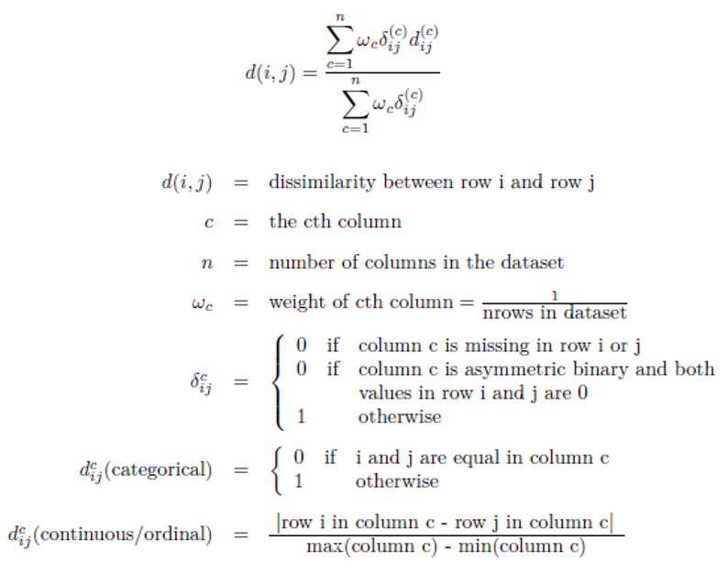
Attributes of Mixed Type: Gower distance
A database may contain all attribute types
Nominal, symmetric binary, asymmetric binary, numeric, ordinal
https://healthcare.ai/clustering-non-continuous-variables/

Slide 14
Example
Based on the information given in the table below, find most similar and most dissimilar persons among them. Apply min-max normalization on income to obtain [0,1] range. Consider profession and mother tongue as nominal. Consider native place as ordinal variable with ranking order of [Village, Small Town, Suburban, Metropolitan]. Give equal weight to each attribute.
Name | Income | Profession | Mother tongue | Native Place
Ram | 70000 | Doctor | Bengali | Village
Balram | 50000 | Data Scientist | Hindi | Small Town
Bharat | 60000 | Carpenter | Hindi | Suburban
Kishan | 80000 | Doctor | Bhojpuri | Metropolitan

Slide 15
Solution
After normalizing income and quantifying native place, we get
d(Ram, Balram) = 0.67+1+1+(2-1)/(4-1)=3 d(Ram, Bharat) = 0.33+1+1+(3-1)/(4-1)=3
d(Ram, Kishan) = 0.33+0+1+(4-1)/(4-1) = 2.33 d(Balram, Bharat) = 0.33+1+0+(3-2)/(4-1)=1.67
d(Balram, Kishan) = 1+1+1+(4-2)/(4-1) = 3.67 d(Bharat, Kishan) = 0.67+1+1+(4-3)/(4-1) = 3
Most similar – Balram and Bharat; Most dissimilar – Balram and Kishan
Name | Income | Profession | Mother tongue | Native Place
Ram | 0.67 | Doctor | Bengali | 1
Balram | 0 | Data Scientist | Hindi | 2
Bharat | 0.33 | Carpenter | Hindi | 3
Kishan | 1 | Doctor | Bhojpuri | 4

Slide 16
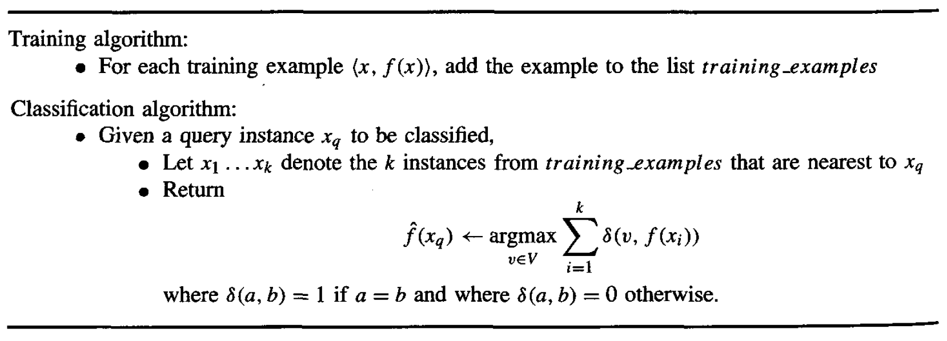
k-Nearest Neighbor Classifier
kNN Classifier - Algorithm
* It can be used for Regression as well.

Slide 17
Steps involved in kNN
Divide the data into training and test data.
Select a value K.
Determine which distance function is to be used.
Choose a sample from the test data that needs to be classified and compute the distance to its n training samples.
Sort the distances obtained and take the k-nearest data samples.
Assign the test class to the class based on the majority vote of its k neighbors.

Slide 18
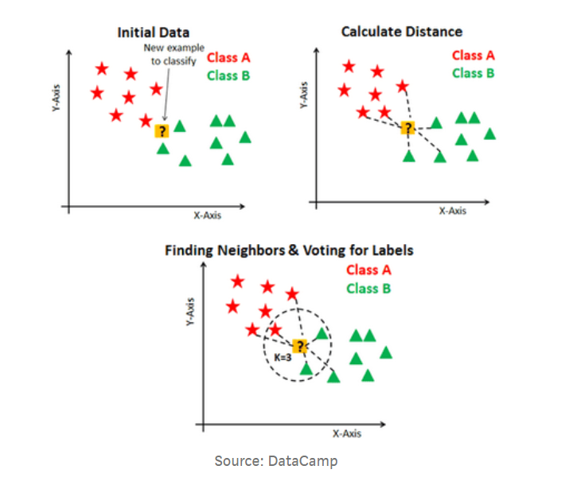
k-Nearest Neighbor Classifier

Slide 19
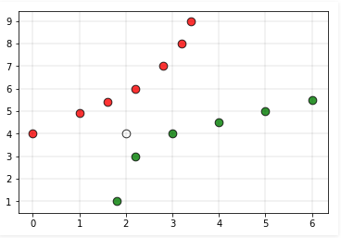
Challenges in k-NN
Performance of a classifier largely depends on the of the hyperparameter k
Choosing smaller values for K, noise can have a higher influence on the result.
Larger values of k are computationally expensive
Assigning the class labels can be tricky. For example, in the below case, for (k=5) the point is closer to ‘green’ classification, but gets classified as ‘red’ due to higher red votes/majority voting to ‘red’

Slide 20
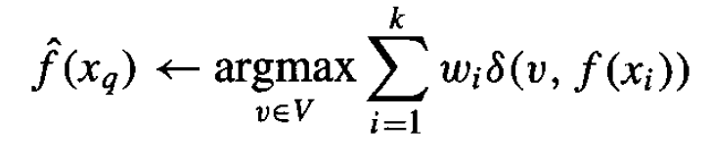
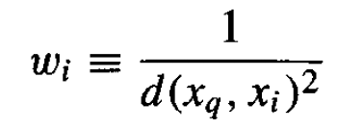
kNN Classifier - Distance weighted
This refinement adds a ”weight” factor to kNN algorithm
Weight would be based on the distance (ex: inverse square of distance from query instance), which gives more weightage to the closer neighbours
Modified function would be:
where
This method is robust to noisy training data and effective for large set of training data
Con for kNN is the well-known “curse of dimensionality”
Can be overcome by weighing each attribute differently while calculating distances or eliminating irrelevant attributes

Slide 21
Factors that affect kNN Performance
Performance of the K-NN algorithm is influenced by the following factors :
The distance function or distance metric used to determine the nearest neighbors.
The number of neighbors (=k) used to classify the new example.

Slide 22
PROS and CONS
Pros
The K-NN algorithm is very easy to implement.
Nearly optimal in the large sample limit.
Uses local information, which can yield highly adaptive behavior.
Cons
Large storage requirements.
Computationally intensive recall.
Highly susceptible to the curse of dimensionality.
Consider all attributes of instances to retrieve similar training examples from memory

Slide 23
Applications
Finance — financial institutes will predict the credit rating of customers.
Healthcare
Political Science — classifying potential voters in two classes will vote or won’t vote.
Handwriting detection.
Image Recognition.

Slide 24
Model Evaluation Measures
Metrics
Precision
Recall
F1
ROC Curve – AUC of ROC
Generating ROC Curve

Slide 25
Classification—A Two-Step Process
Model construction: describing a set of predetermined classes
Each tuple/sample is assumed to belong to a predefined class, as determined by the class label attribute
The set of tuples used for model construction is training set
The model is represented as classification rules, decision trees, or mathematical formulae
Model usage: for classifying future or unknown objects
Estimate accuracy of the model
The known label of test sample is compared with the classified result from the model
Accuracy rate is the percentage of test set samples that are correctly classified by the model
Test set is independent of training set, otherwise over-fitting will occur
If the accuracy is acceptable, use the model to classify data tuples whose class labels are not known

Slide 26
Illustrating Classification Task

Slide 27
Classifier Evaluation Metrics: Confusion Matrix
Confusion Matrix:
Given m classes, an entry, CM_{i,j} in a confusion matrix indicates # of tuples in class i that were labeled by the classifier as class j
May have extra rows/columns to provide totals
True Positive (TP): It refers to the number of
predictions where the classifier correctly predicts
the positive class as positive.
True Negative (TN): It refers to the number of
predictions where the classifier correctly predicts
the negative class as negative.
False Positive (FP): It refers to the number of
predictions where the classifier incorrectly
predicts the negative class as positive.
False Negative (FN): It refers to the number of
predictions where the classifier incorrectly predicts
the positive class as negative.
Predicted class -> | C₁ | ¬ C₁
Actual class⇓
C₁ | True Positives (TP) | False Negatives (FN)
¬ C₁ | False Positives (FP) | True Negatives (TN)
27

Slide 28
Classifier Evaluation Metrics: Accuracy, Error Rate,
Classifier Accuracy, or recognition rate: percentage of test set tuples that are
correctly classified
Accuracy = (TP + TN)/All
most effective when the class distribution is relatively balanced
Classification Error/ Misclassification rate: 1 – accuracy, or
= (FP + FN)/All
A\P | C | ¬C
C | TP | FN | P
¬C | FP | TN | N
 | P’ | N’ | All
28

Slide 29
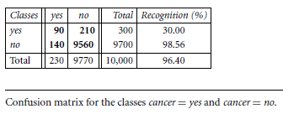
Example
Given below is a confusion matrix for medical data where the class values are yes and no for a class label attribute, cancer. Calculate the accuracy of the classifier.

Slide 30
Classifier Evaluation Metrics: Example
Actual Class\Predicted class | cancer = yes | cancer = no | Total | Recognition(%)
cancer = yes | 90 | 210 | 300 | 30.00 (sensitivity
cancer = no | 140 | 9560 | 9700 | 98.56 (specificity)
Total | 230 | 9770 | 10000 | 96.40 (accuracy)
30

Slide 31
Class Imbalance Problem
The main class of interest is rare.
the data set distribution reflects a significant majority of the negative class and a minority positive class.
For example,
fraud detection applications, the class of interest (or positive class) is “fraud,”
medical tests, there may be a rare class, such as “cancer”
Accuracy might not be a good option for measuring performance in case of class imbalance problem

Slide 32




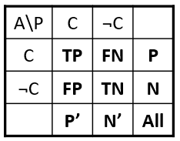
Model Evaluation Measures
True positive rate (TPR) or sensitivity is defined as the fraction of positive examples predicted correctly by the model
True negative rate (TNR) or specificity is defined as the fraction of negative examples predicted correctly by the model
False positive rate (FPR) is the fraction of negative examples predicted as a positive class
False negative rate (F N R) is the fraction of positive examples predicted as a negative class

Slide 33
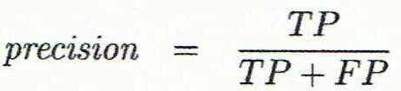
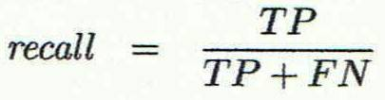
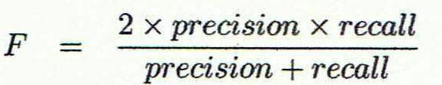
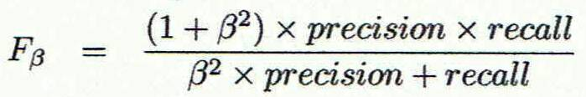
Classifier Evaluation Metrics: Precision and Recall, and F-measures
Precision: exactness – what % of tuples that the classifier labeled as positive are actually positive
Recall/Sensitivity: completeness – what % of positive tuples did the classifier label as positive?
Perfect score is 1.0
Inverse relationship between precision & recall
F measure (F₁ or F-score): harmonic mean of precision and recall,
High value of F₁ measure ensures that both precision and recall are high
F_{ß}: weighted measure of precision and recall
assigns ß times as much weight to recall as to precision
33

Slide 34
Classifier Evaluation Metrics: Example
Precision = 90/230 = 39.13% Recall = 90/300 = 30.00%
Actual Class\Predicted class | cancer = yes | cancer = no | Total | Recognition(%)
cancer = yes | 90 | 210 | 300 | 30.00 (sensitivity
cancer = no | 140 | 9560 | 9700 | 98.56 (specificity)
Total | 230 | 9770 | 10000 | 96.40 (accuracy)
34

Slide 35
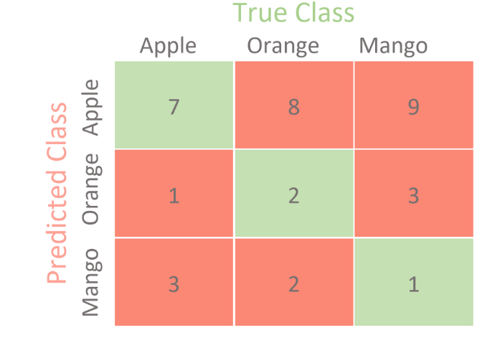
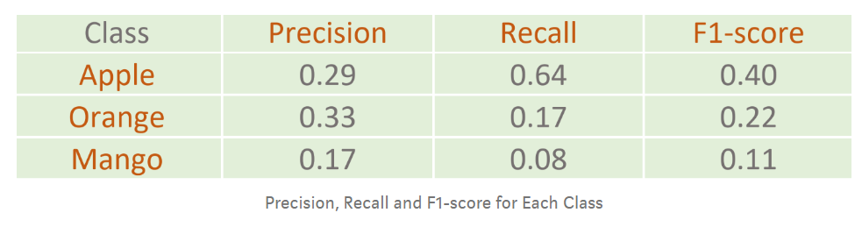
Example: Contingency for Multi-Class Classifier

Slide 36
Evaluating Classifier Accuracy: Holdout & Cross-Validation Methods
Holdout method
Given data is randomly partitioned into two independent sets
Training set (e.g., 2/3) for model construction
Test set (e.g., 1/3) for accuracy estimation
Random sampling: a variation of holdout
Repeat holdout k times, accuracy = avg. of the accuracies obtained
Cross-validation (k-fold, where k = 10 is most popular)
Randomly partition the data into k mutually exclusive subsets, each approximately equal size
At i-th iteration, use D_{i} as test set and others as training set
*Stratified cross-validation*: folds are stratified so that class dist. in each fold is approx. the same as that in the initial data
The Accuracy of the model is the average of the accuracy of each fold.
36

Slide 37
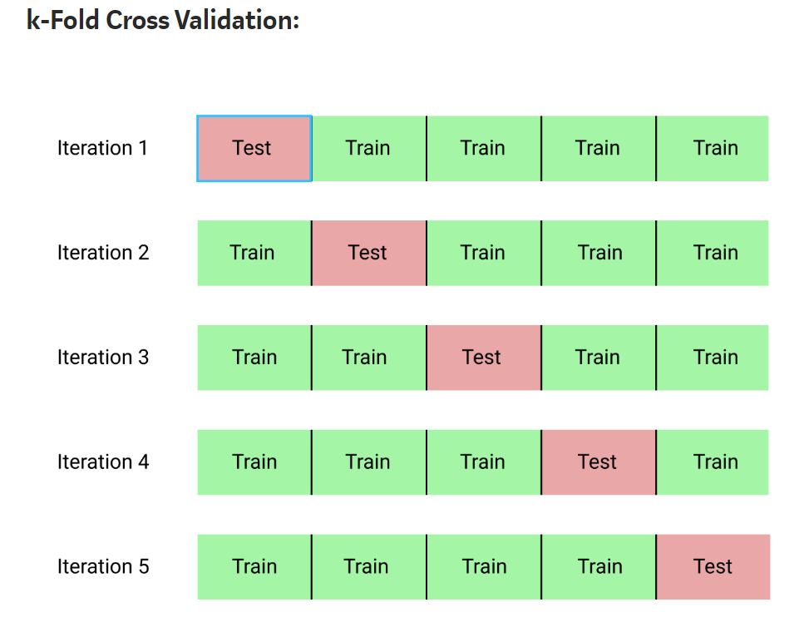
Cross Validation

Slide 38
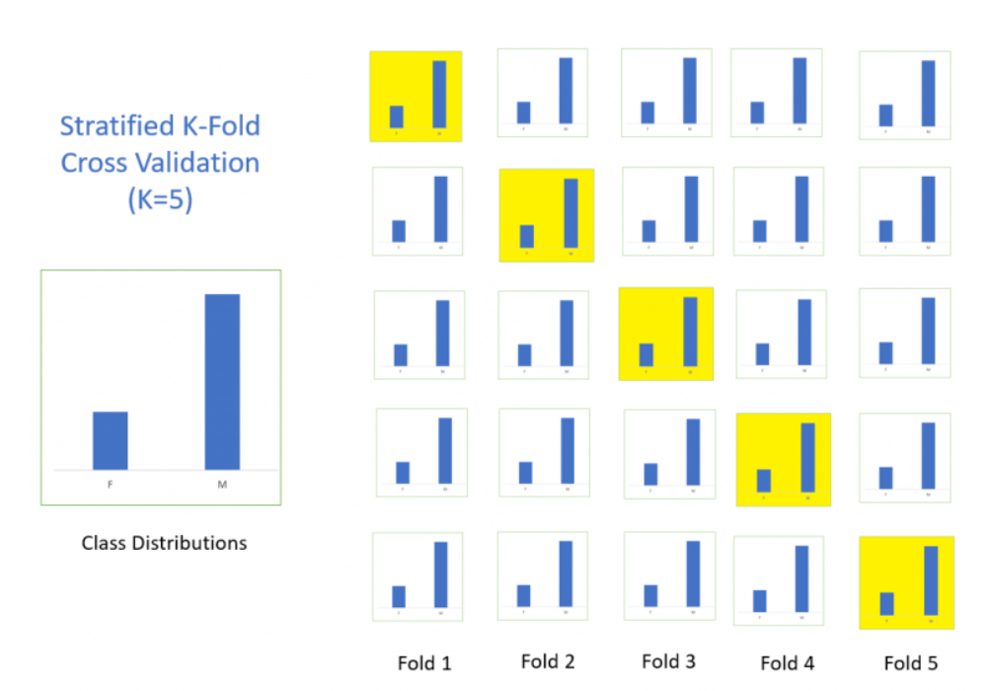
Stratified Cross Validation

Slide 39
Receiver Operating Characteristic (ROC) Curve
ROC curve plots TPR and FPR, to graphically represent their trade-off
AUC represents degree or measure of separability. It tells how much model is capable of distinguishing between classes.
Higher the AUC, better the model is at predicting
Area Under Curve (AUC) of ROC – evaluates model performance on average
AUC of ROC = 1, for a perfect model
AUC of ROC = 0.5, if the model is random
For model comparison, AUC of ROC should be larger for the model to be superior or better performing

Slide 40
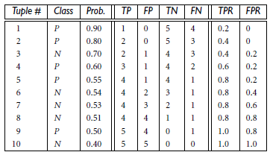
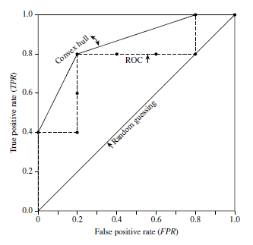
Example
The table below shows the probability value (column 3) returned by a probabilistic classifier for each of the 10 tuples in a test set, sorted by decreasing probability order. The corresponding ROC is given on right hand side.

Slide 41
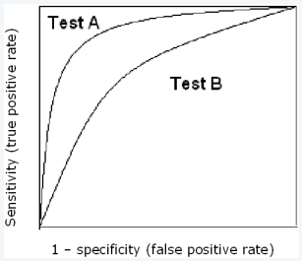
Usage
Threshold selection
Performance assessment
Classifier comparison

Slide 42
Finding optimal k for kNN classifiers
The problem of finding K
Optimal K

Slide 43
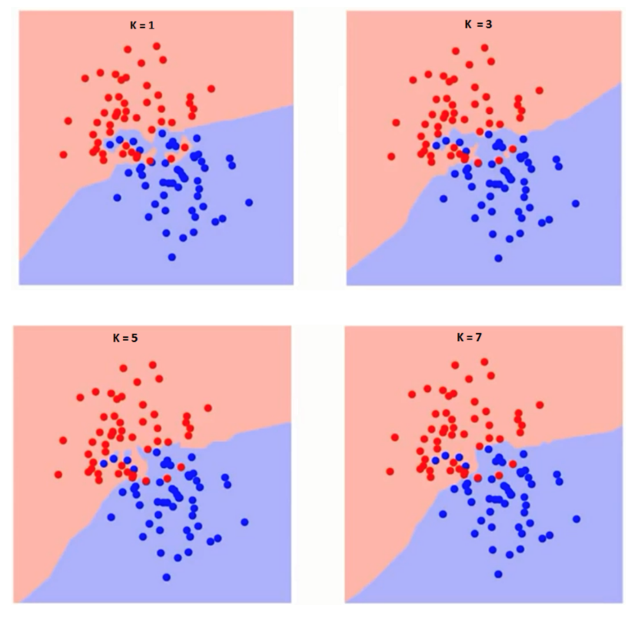
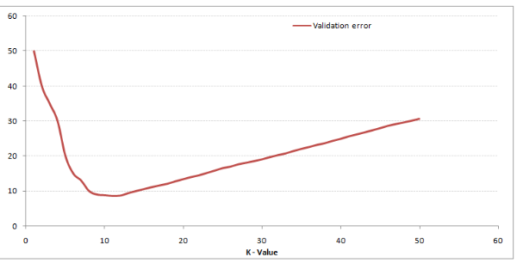
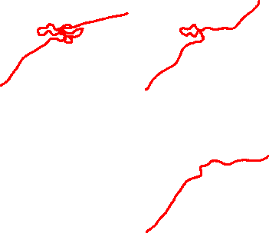
Finding optimal k for kNN classifiers
What is the ideal value of ‘K’?

Slide 44
Practise Problems
Tune KNN. Try different values of k to see if you can improve the performance of the algorithm.
Use weighted kNN and check the performance
Regression. Apply it to a regression predictive modeling problem (e.g. predict a numerical value)
More Distance Measures. Implement other distance measures such as Hamming distance, Manhattan distance and Minkowski distance.
Data Preparation. Distance measures are strongly affected by the scale of the input data. Experiment with standardization and other data preparation methods in order to improve results.
Dealing with categorical attributes

Slide 45
Thank You

